Slide 1


Slide 2
Number of temporary visa holders
Student
Working holiday maker
Temporary work
Source: Department of Home Affairs Annual Report 1996-2018

Slide 3
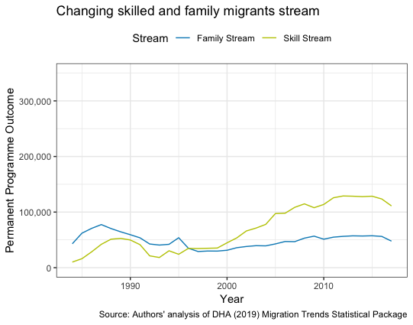
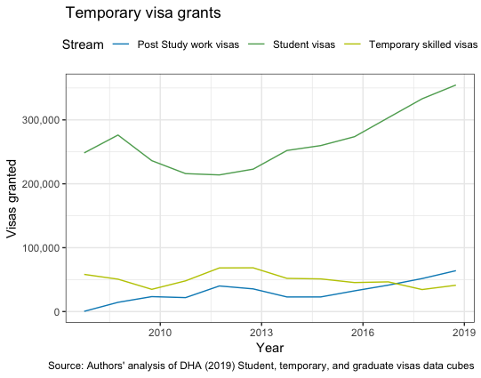
Migrants to Australia over time

Slide 4
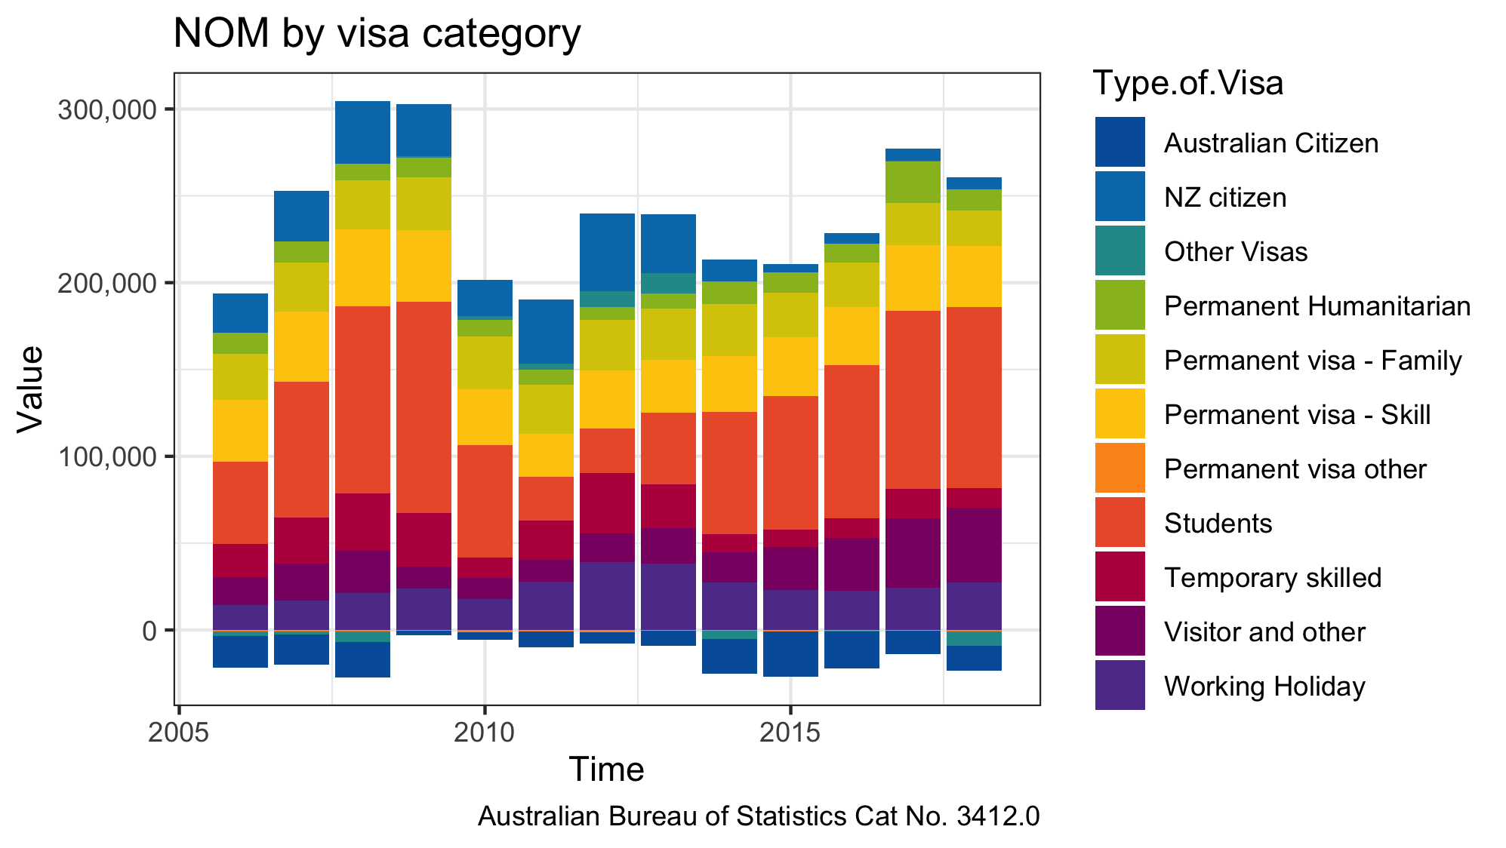
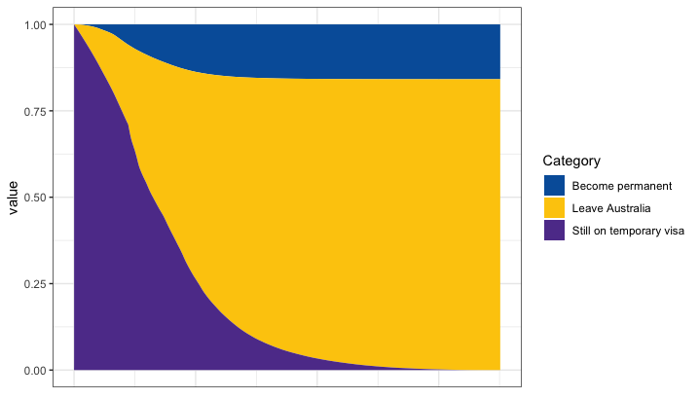
Myth: Temporary migration contributes to population growth
Nom is a measure of entry and exit
Not a measure of population growth
Micro-level longitudinal data

Slide 5
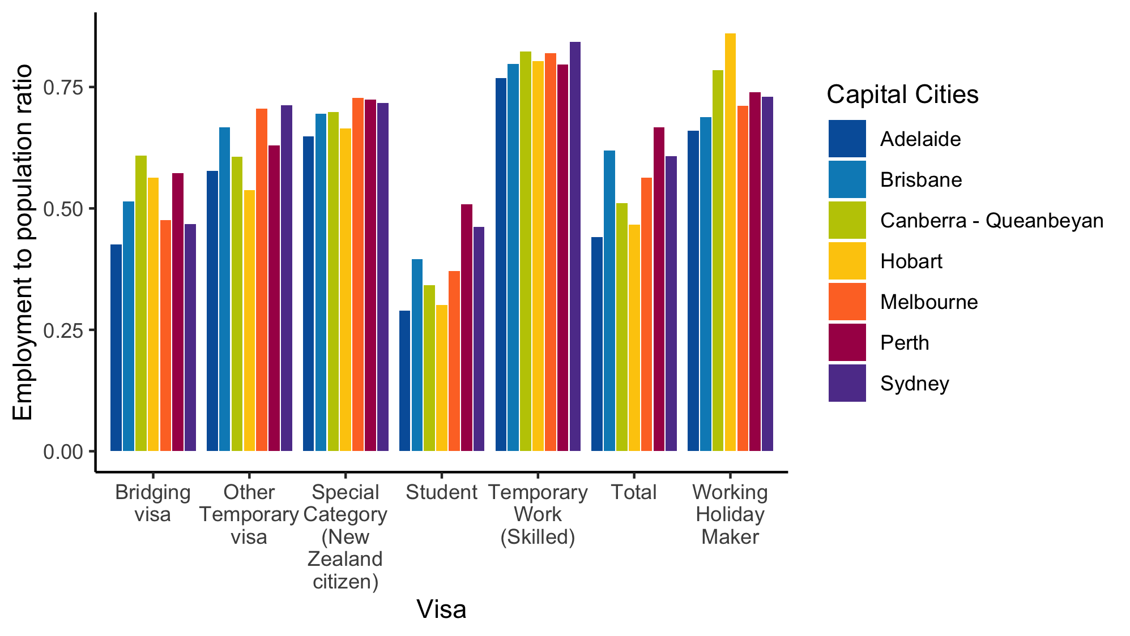
International Students and graduates
Work rights
High skilled and low skilled
Low transition to permanent visas (Treasury 2019)
Source: Australian Bureau of Statistics (2019) ACTEID 2016 Cat no. 3419.0

Slide 6
International Student graduates
Significant uptake over time
More than doubled over the last four years
Still concentrated in relatively low wage occupation, part-time work
Source: Australian Bureau of Statistics (2019) ACTEID 2016 Cat no. 3419.0

Slide 7
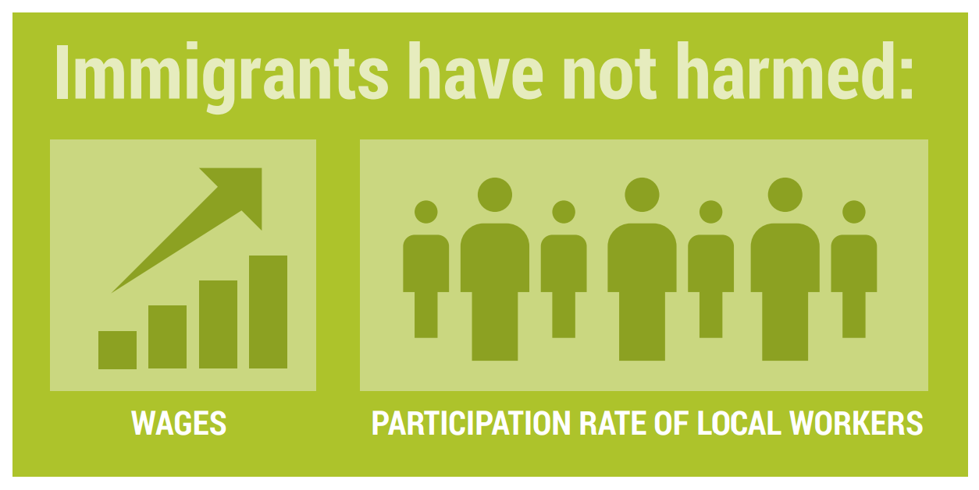
Modelling the impact of recent migrants
Following methodology from PC migrant intake review
Looking at recent migrants characteristics

Slide 8

Actions that can be taken immediately:
Increasing transparency around the skilled occupation list.
Aligning emerging labour trends to occupation codes.
Creating a dedicated path for intra-company transfer of employees to Australia

Slide 9

Better aligning the Skilling Australia Fund Levy to alleviate the skill shortages.
Creating an independent committee to analyse and consult on the skilled occupation lists.
A regular Productivity Commission review of the temporary skilled visa program.
Moving the levy collection to the visa approval stage.

Slide 10
